Slide 1
Lecture 10 Genetic Algorithm
CS 180 – Intelligent Systems
Dr. Victor Chen
Fall 2022

Slide 2
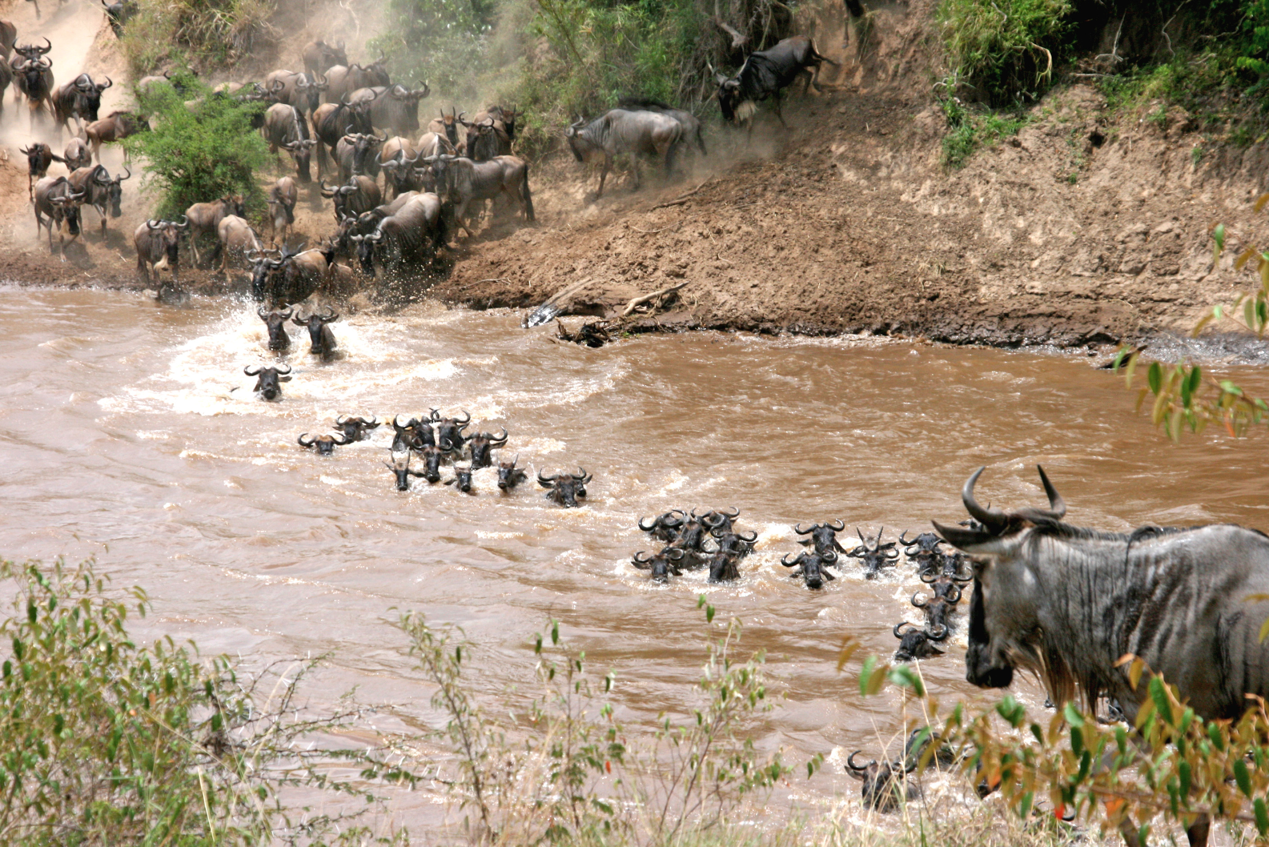
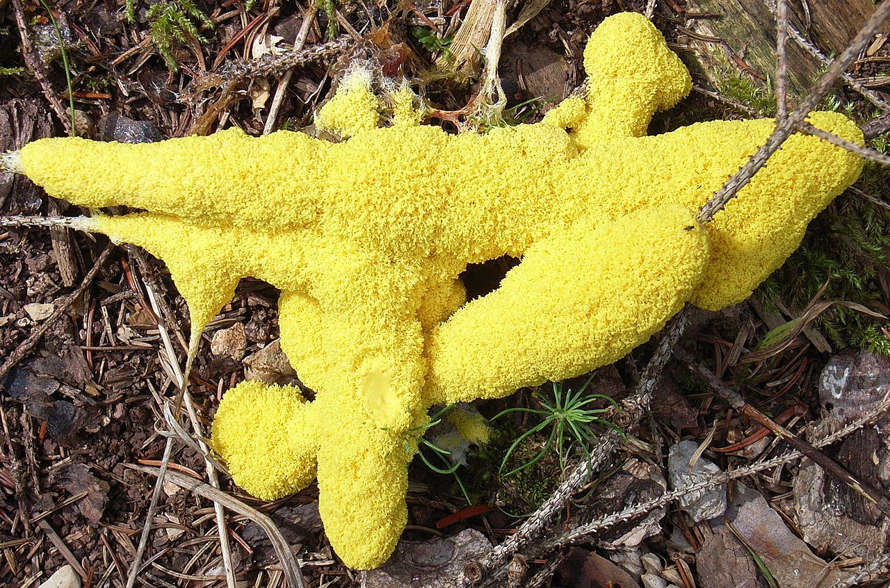
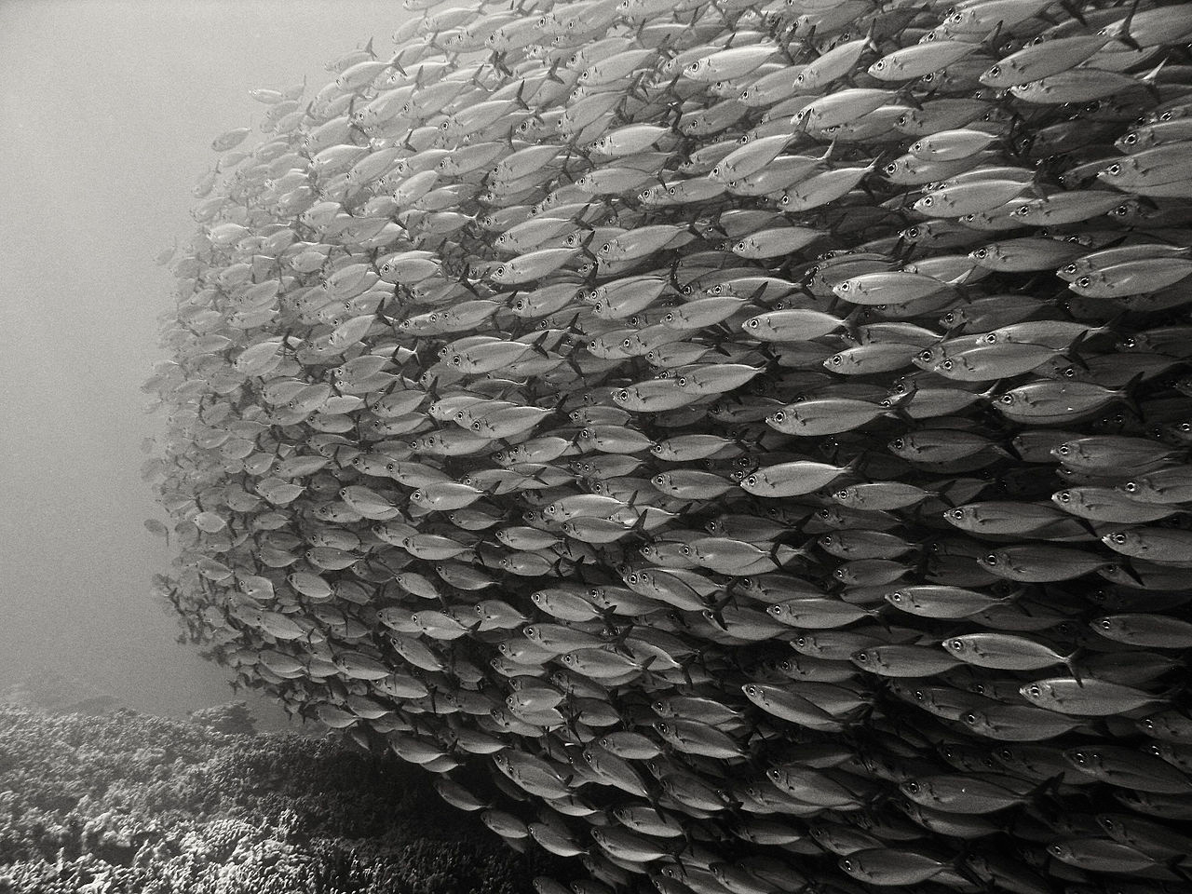
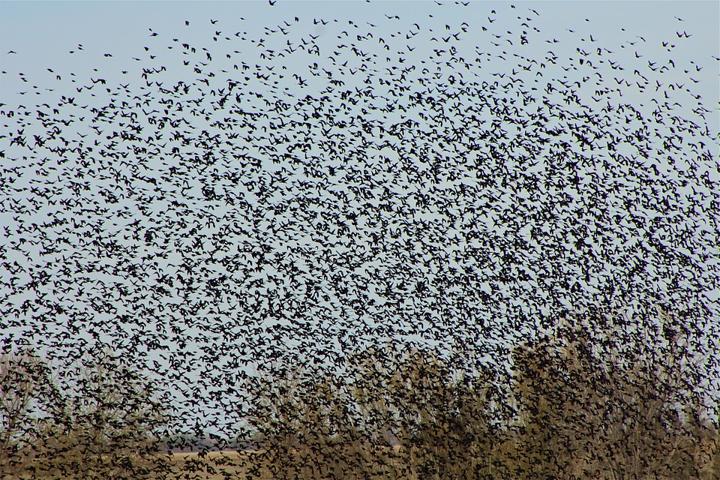
Nature-inspired algorithms
Genetic Algorithm (GA)
Particle Swarm Optimization (PSO)
Ant Colony Optimization (ACO)
Artificial Bee Colony (ABC).
Bird Swarm Algorithm (BSA)

Slide 3
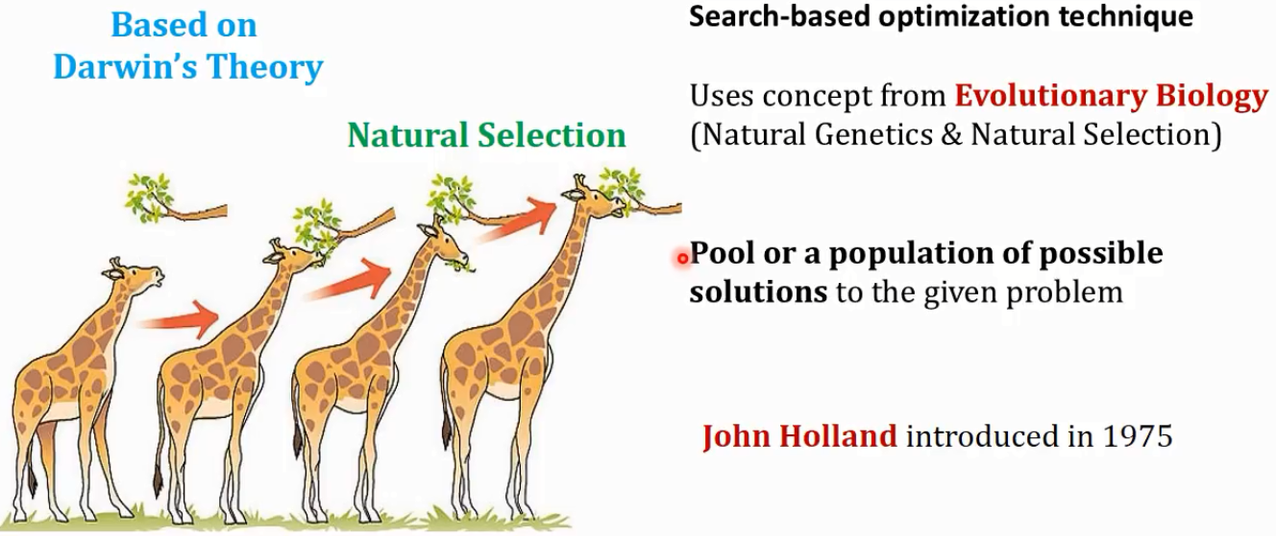
Genetic Algorithm

Slide 4
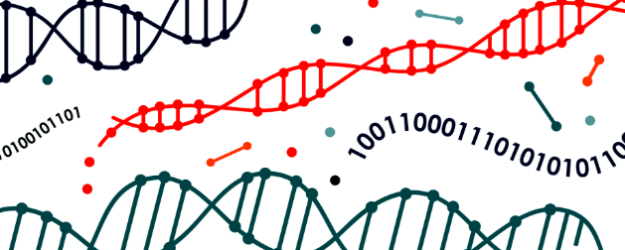
Intuition of GA
You are head of a country, and in order to keep your city safe from bad things, you implement a policy like this:
You select all the good people, and ask them to extend their generation by having their children.
This repeats for a few generations.
You will notice that now you have an entire population of good people.

Slide 5
An Overview Of GA
GA creates a “population”, or to say, a “group” of possible solutions to the given problem and lets them “evolve” over multiple generations to find better and better solutions.

Slide 6

Applications

Slide 7
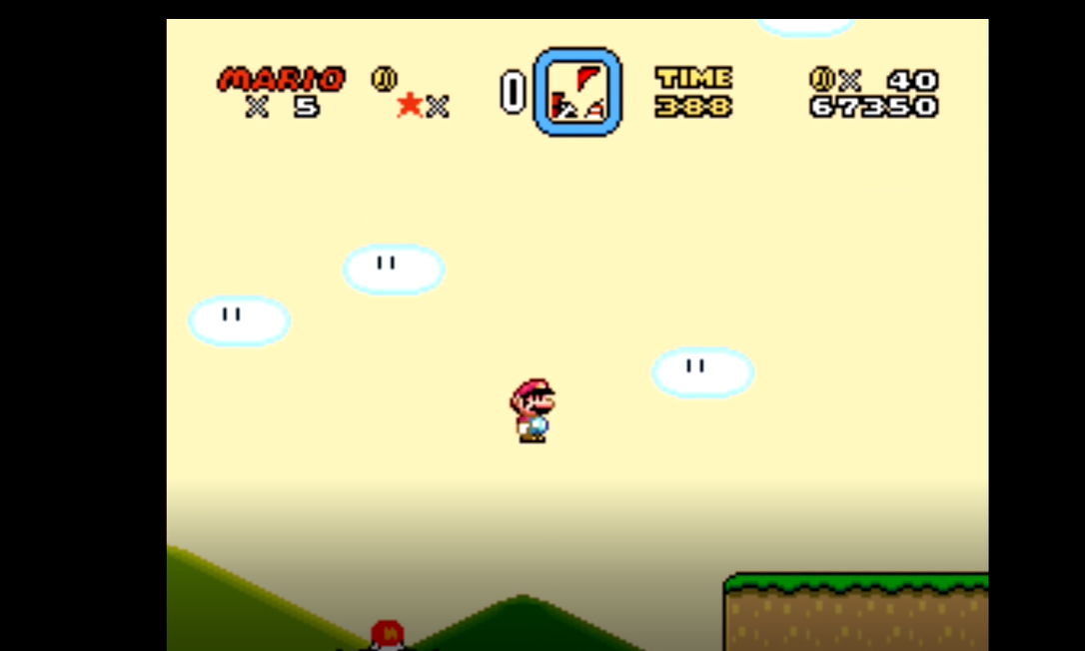
When GA Meets Super Mario

Slide 8
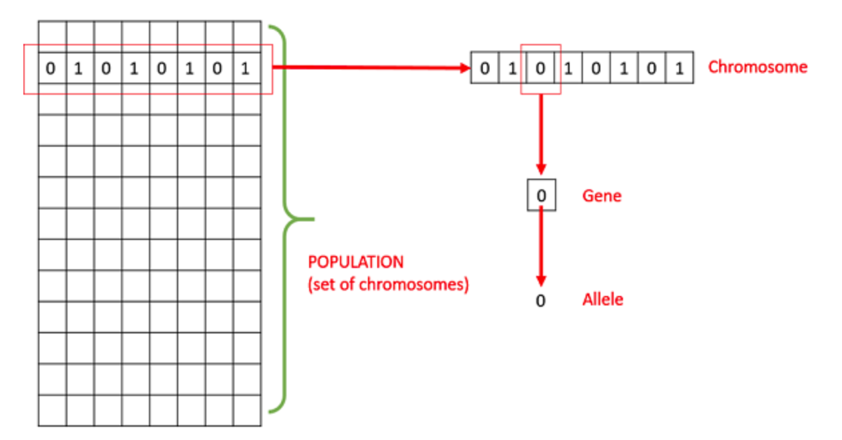
Basic Terminology
Population − It is a subset of possible (encoded) solutions.
Chromosome (individual) − A chromosome (individual) is one possible solution
Gene − A gene is one element position of a chromosome.
Allele − It is the value a gene takes.

Slide 9
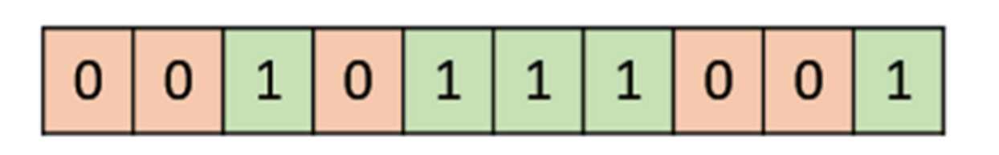
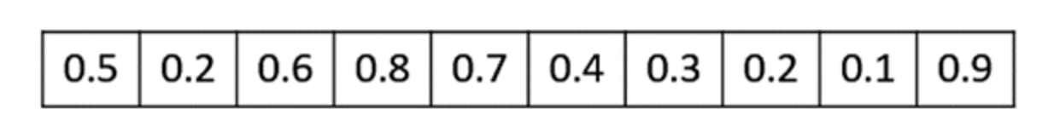
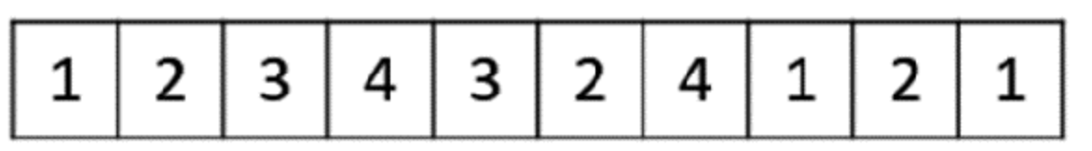
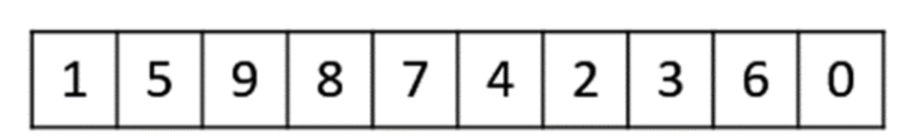
Think about possible solution representations (encoding)
Binary Representation (bit strings)
Real Valued Representation
Integer Representation
Permutation Representation (each solution is an ordering of elements)
E.g., Travelling salesman problem (TSP)

Slide 10
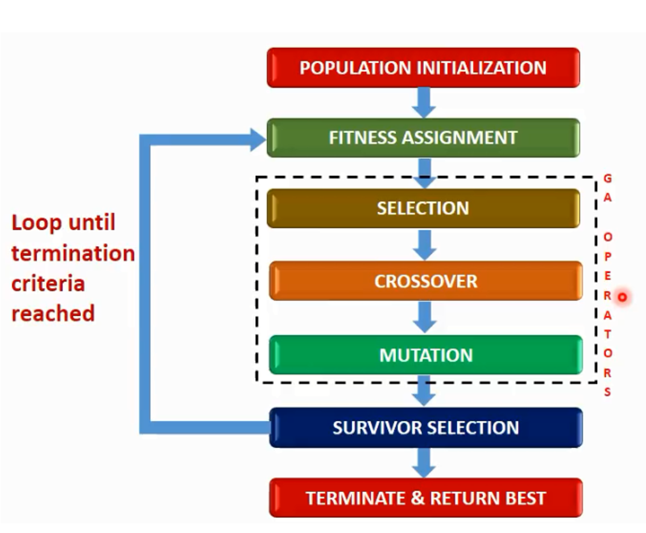
Basic Structure of Genetic Algorithm
Two possible GA models
Steady State GA: We generate one or two off-springs in each iteration and they will replace one or two individuals from the current population.
Generational GA: We generate ‘n’ off-springs, where n is the population size, and the entire population will be replaced by those new ones at the end of each iteration.

Slide 11
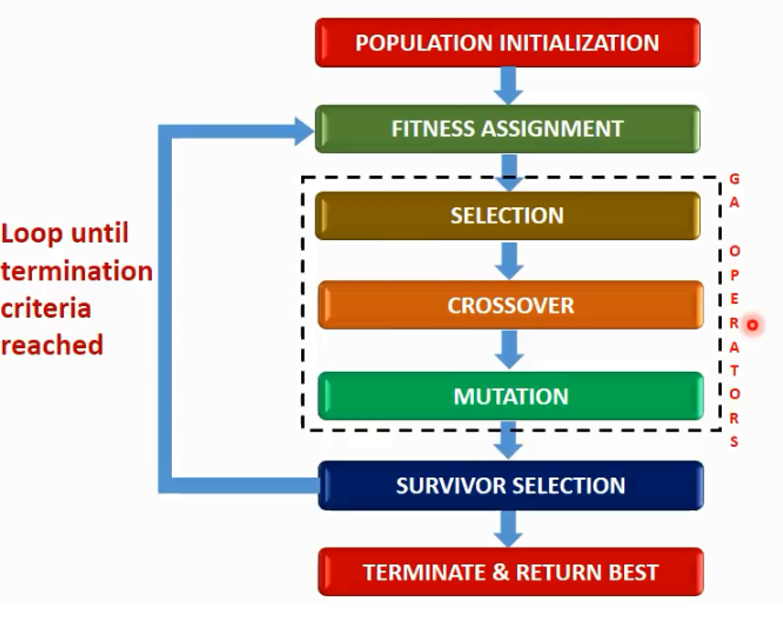
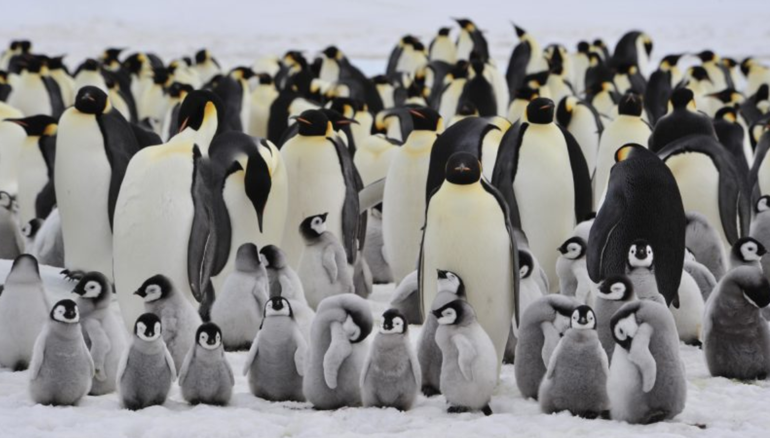
Population Initialization
Populate the initial population with random individuals.

Slide 12
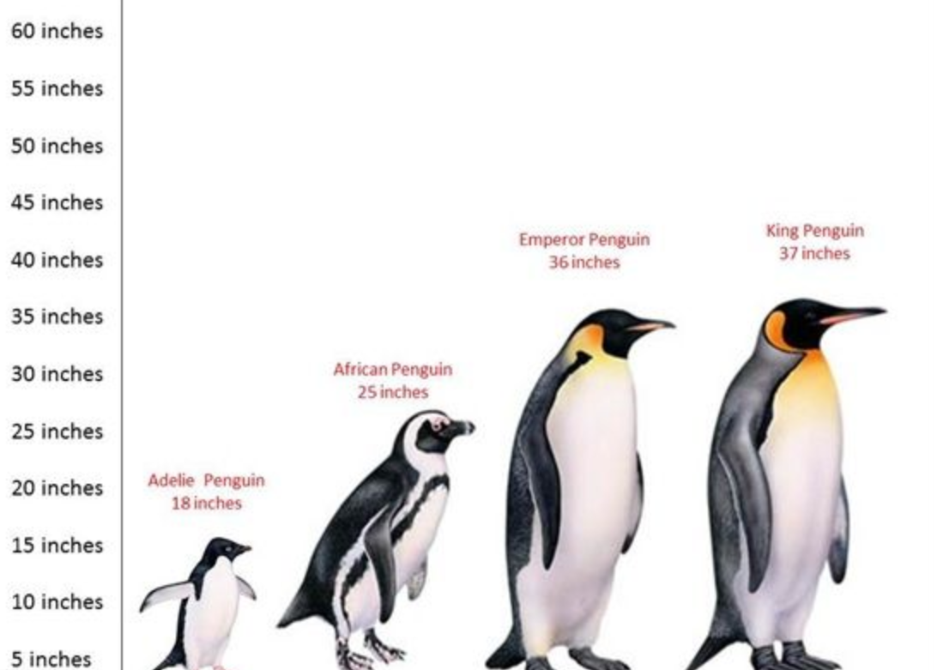
Fitness Function
The fitness function measures the goodness value of the individual
The fitness function should be sufficiently fast to compute

Slide 13
Parent Selection
Select parents who are allowed to create their off-springs
for the next generation.
Three methods:
1. Fitness Proportionate Selection
2. K-Way Tournament Selection
3. Rank Selection

Slide 14
Fitness Proportionate Selection
Fitness Proportionate Selection: Every individual can become a parent with a probability which is proportional to its fitness.
Two implementations:
Roulette Wheel Selection
Stochastic Universal Sampling (SUS)

Slide 15
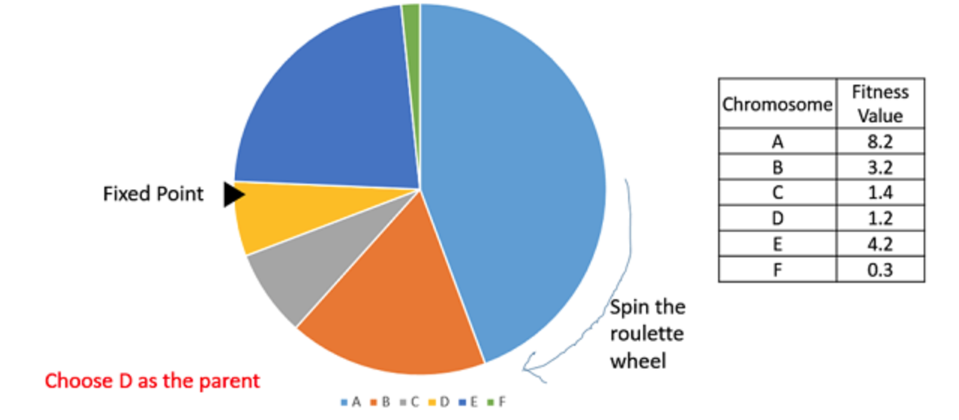
Roulette Wheel Selection
The wheel is divided into n pies, where n is the number of individuals in the population (population size).
Each individual gets a portion of the circle which is proportional to its fitness value.
Just one fixed point. The region which comes in front of the fixed point is chosen as the parent.
For the second parent, the same process is repeated.

Slide 16
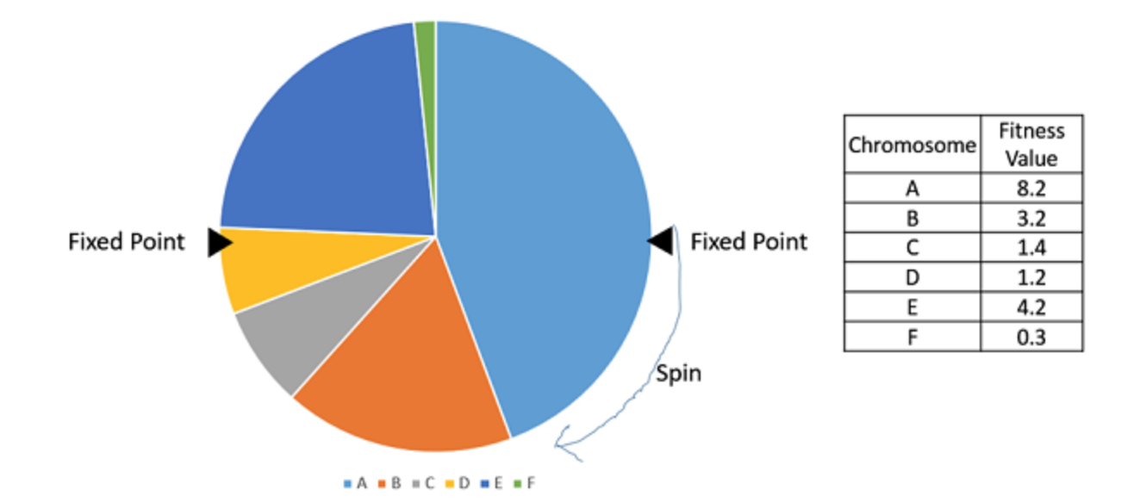
Stochastic Universal Sampling (SUS)
The wheel has N equally spaced fixed points
Therefore, all N parents are chosen in just one spin of the wheel

Slide 17
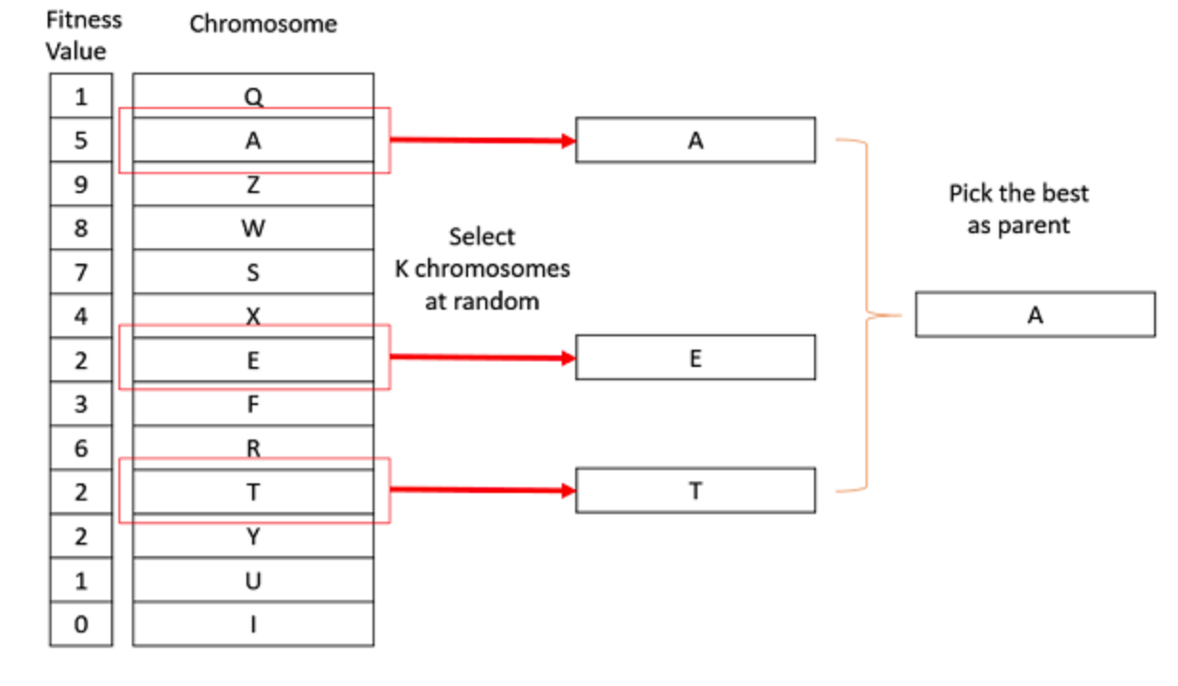
K-Way Tournament Selection
We select K individuals from the population at random and select the best out of these to become a parent.
The same process is repeated for selecting the next parent.

Slide 18
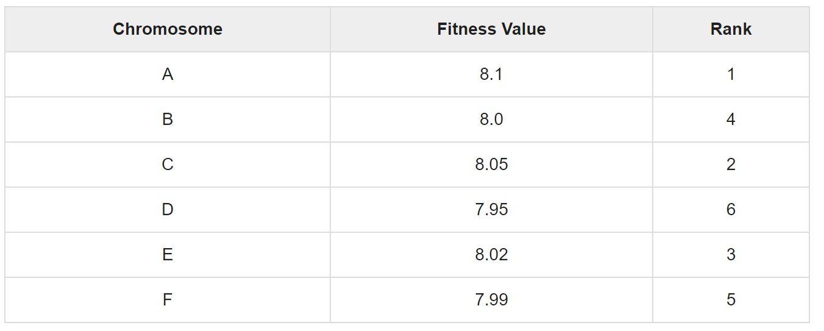
Rank Selection
Every individual in the population is ranked according to their fitness.
The selection of the parents depends on the rank of each individual rather than the fitness.
The higher ranked individuals are preferred more than the lower ranked ones.

Slide 19
Crossover (exploitation)
Random crossover point(s) are selected and segments are swapped to get new off-springs.
1 point cross-over
1 | 0 | 1 | 0 | 0 | 1 | 0 | 0
0 | 0 | 1 | 1 | 0 | 1 | 1 | 1
P₁
1 | 0 | 1 | 1 | 0 | 1 | 1 | 1
D₁
P₂
0 | 0 | 1 | 0 | 0 | 1 | 0 | 0
D₂
2-points cross-over
1 | 0 | 1 | 0 | 0 | 1 | 0 | 0
0 | 0 | 1 | 1 | 0 | 1 | 1 | 1
P₁
1 | 0 | 1 | 0 | 0 | 1 | 1 | 0
D₁
P₂
0 | 0 | 1 | 1 | 0 | 1 | 0 | 1
D₂

Slide 20
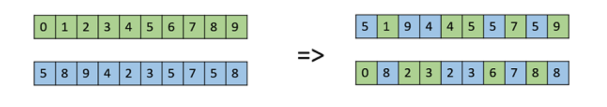
Crossover (exploitation)
Uniform Crossover: We treat each gene separately. We flip a coin for each gene to decide whether it’ll be swapped or not in the off-springs based on heads-up or heads-down.

Slide 21
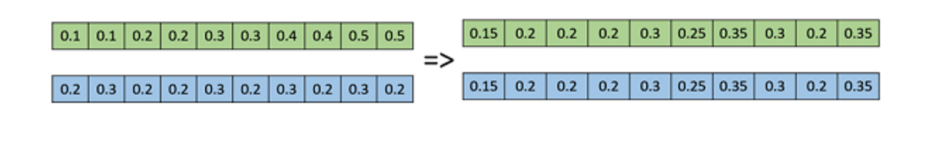
Arithmetic Recombination Crossover
This is commonly for integer/real representations by taking the weighted average of the two parents :
Child1 = α.x + (1-α).y
Child2 = α.y + (1-α).x
Obviously, if α = 0.5, then both the children will be identical.

Slide 22
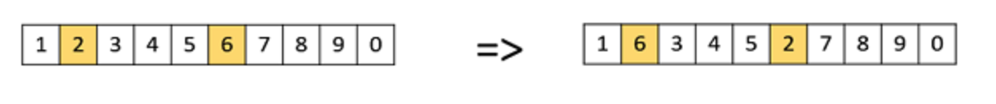
Mutation (exploration)
Bit Flip Mutation
select one or more random bits and flip them. This is used for binary encoded GAs.
Swap Mutation
select two random positions on the chromosome, and interchange the values

Slide 23
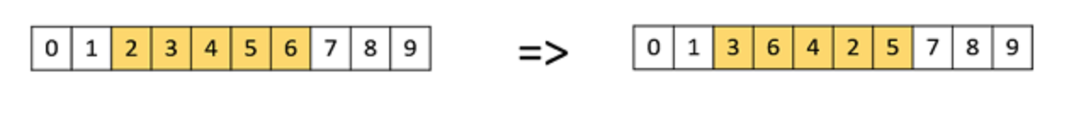
Mutation
Scramble Mutation
a subset of genes is chosen and their values are shuffled randomly.

Slide 24
Survivor Selection
Steady State GA vs Generational GA
Determines which individuals are to be kicked out from the next generation.
The idea here is to ensure that the fitter individuals are not kicked out, while at the same time diversity should be maintained in the population
Age Based Selection
Fitness Based Selection

Slide 25
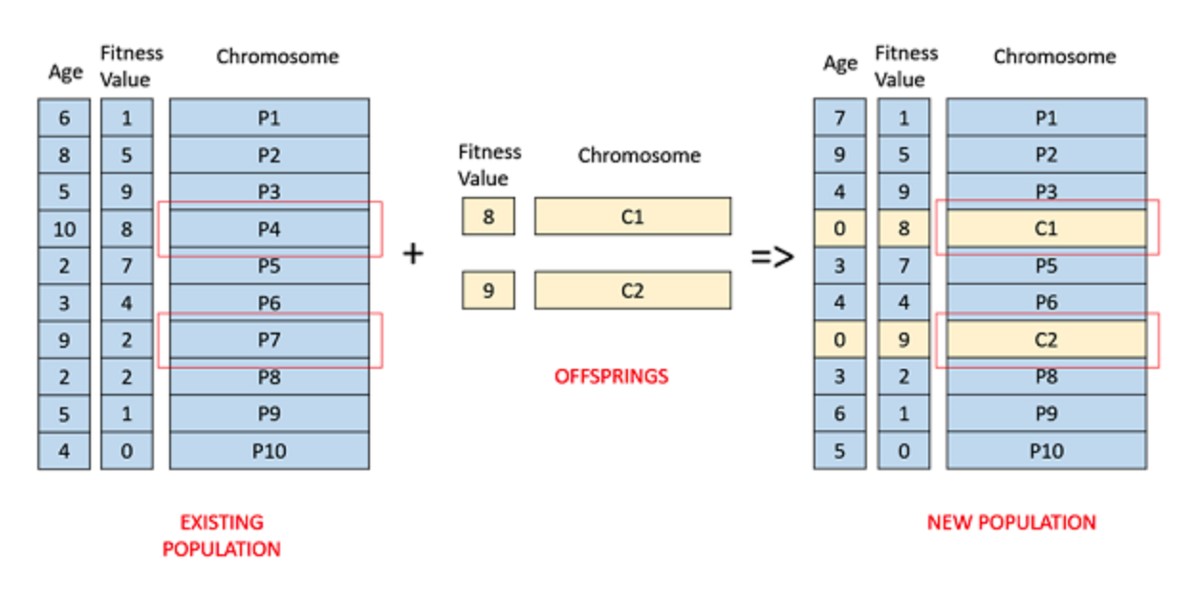
Age Based Selection
Each individual is allowed in the population for a finite generation. After that, it is kicked out of the population no matter how good its fitness is.
No fitness used

Slide 26
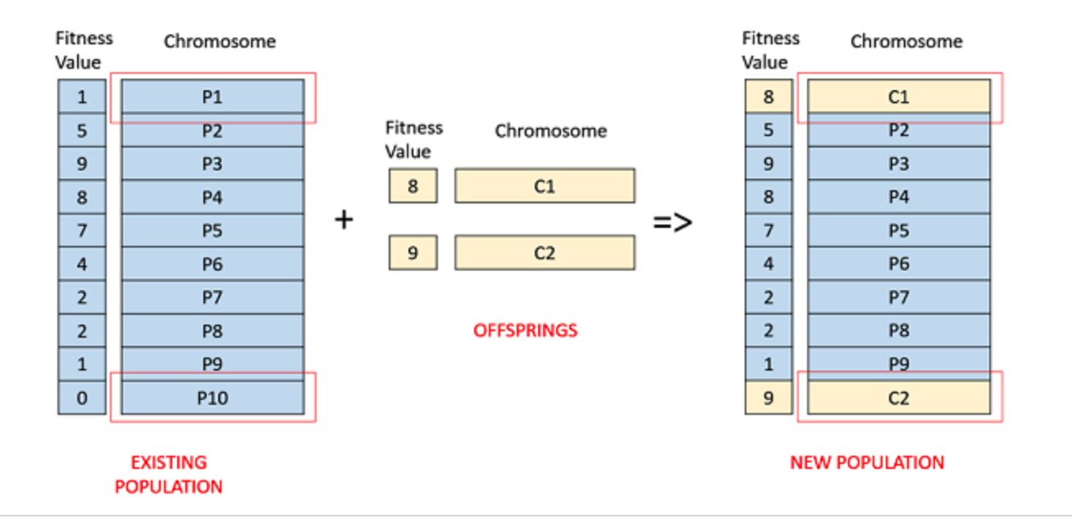
Fitness Based Selection
The children replace the least fit individuals in the population.

Slide 27
Termination Condition
The above process repeats until some termination conditions are reached
When we reach an certain number of generations.
When the objective function value has reached a certain pre-defined value.

Slide 28
GA Example 1
FUNCTION MAXIMIZATION
Determine the variables that produce the maximum value for this function:

Slide 29
Questions that need to be answered to use GA
How is an individual represented?
How is an individual’s fitness calculated?
How are individuals selected for mating?
How are individuals crossed-over?
How are individuals mutated?

Slide 30
1. How is an individual represented?
Choose a binary sequence for each variable, and then concatenate the four values together into a single bit string.
1101 0110 0111 1100
represents a solution where w = 13, x = 6, y = 7, and z = 12.

Slide 31
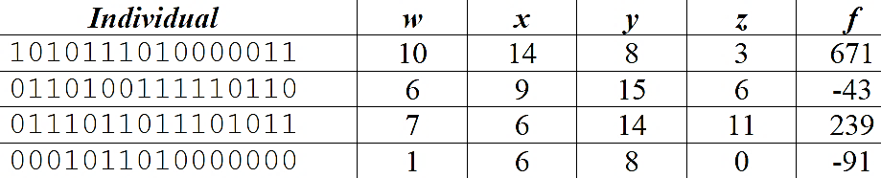
2. How is an individual’s fitness calculated?
Assume we have a population of 4 individuals:

Slide 32
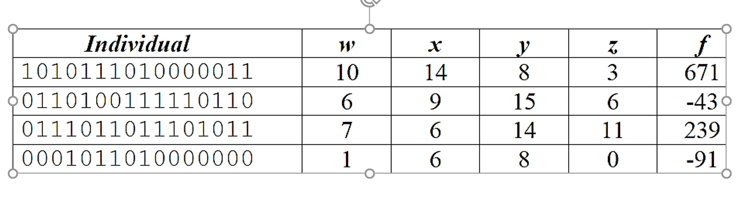
3. How are individuals selected for mating?
Suppose we use rank selection where individuals are ranked according to their fitness.
the first individual a 40% chance of being selected
the second a 20% chance
the third a 30% chance
the fourth a 10% chance
Clearly this is giving the better individuals more chances to be selected.

Slide 33
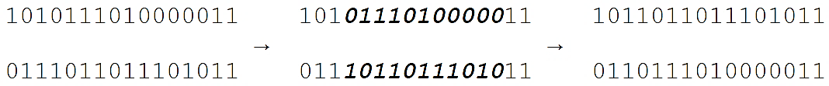
4. How are individuals crossed-over?
Suppose we use 2-points cross-over
Assume that the 1st and 3rd individuals are selected this time.
1010 1110 1000 0011
0110 1001 1111 0110
0111 0110 1110 1011
0001 0110 1000 0000
The 4th and 14th bits are randomly selected to define the substring to be swapped, so the cross-over looks like this:
Thus, two new individuals are created.

Slide 34
Suppose we use generational-GA:
We generate ‘n’ off-springs, where n is the population size, and the entire population is replaced by the new one at the end of the iteration.
We should keep creating new individuals until we have created enough to replace the entire population.

Slide 35
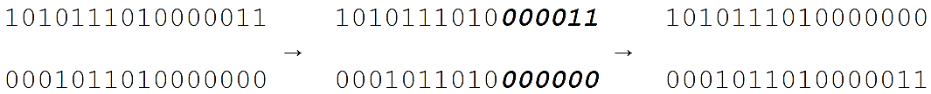
Assume that the 1st and 4th individuals are selected this time.
Note that an individual may be selected multiple times for breeding, while other individuals might never be selected.
Further assume that the 11th and 16th bits are randomly selected for the cross-over point.
We would see a second cross-over like this:
So, we have four new offsprings:
1011 0110 1110 1011
0110 1110 1000 0011
1010 1110 1000 0000
0001 0110 1000 0011

Slide 36
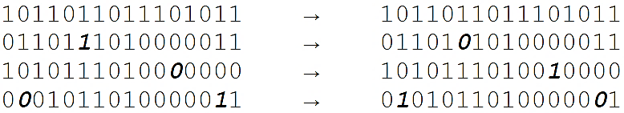
5. How are individuals mutated?
The selected policy: Allow every single bit a small chance to mutate.
Best practice: setting the mutate probability so that roughly 1 bit per individual will change on average.
The mutation will have the bit “flip” – 1 to 0 and 0 to 1.

Slide 37
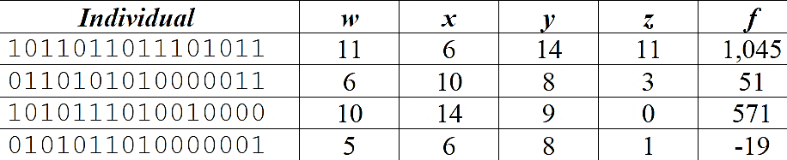
Wrapping Up: We get 2-nd generation

Slide 38
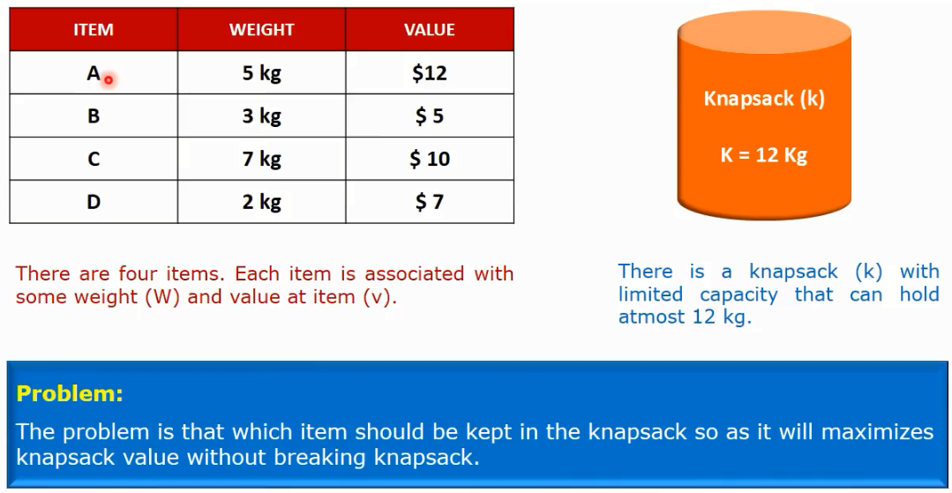
GA Example 2
Knapsack Problem

Slide 39
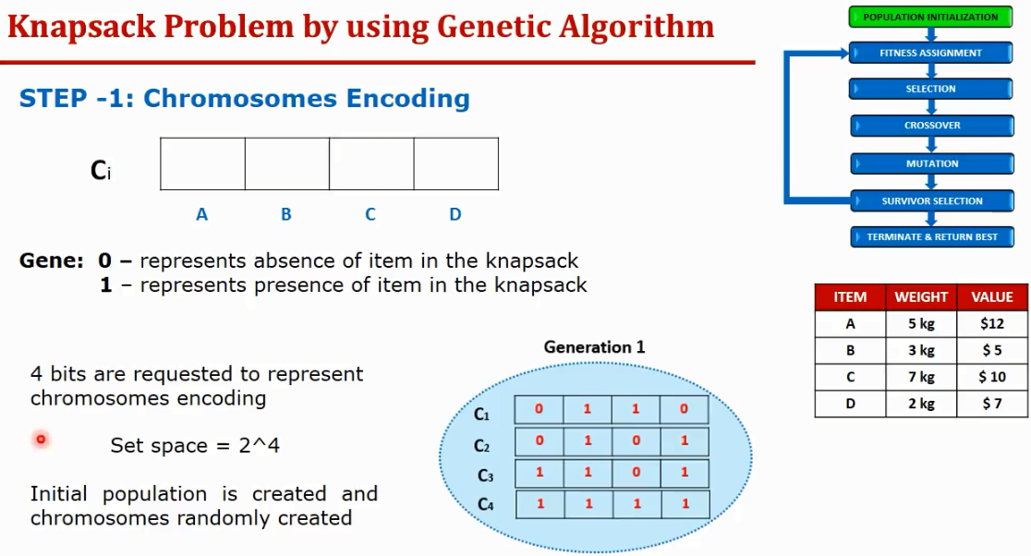

Slide 40
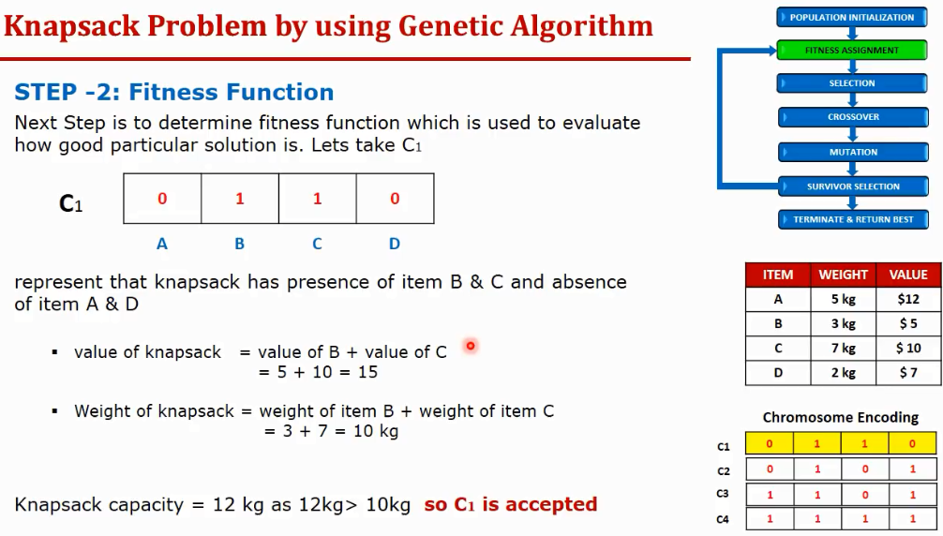

Slide 41
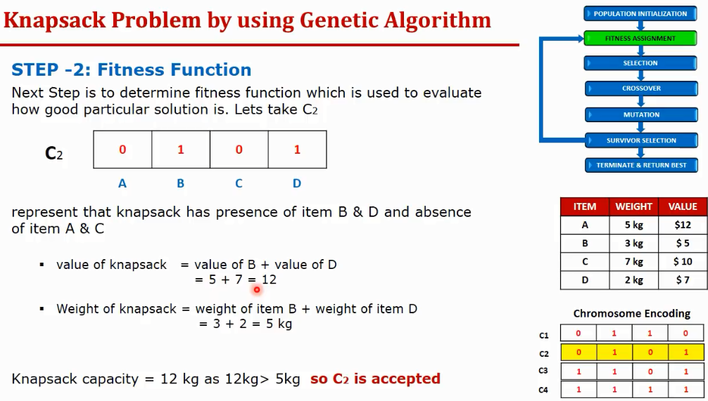

Slide 42
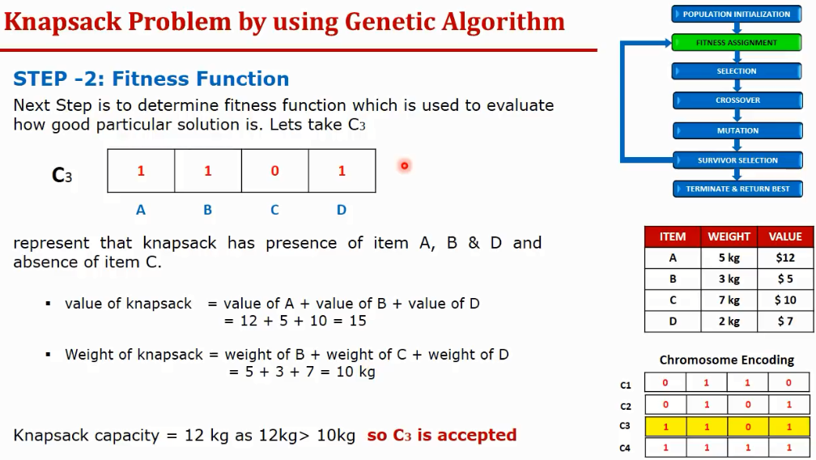
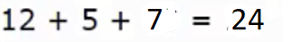

Slide 43
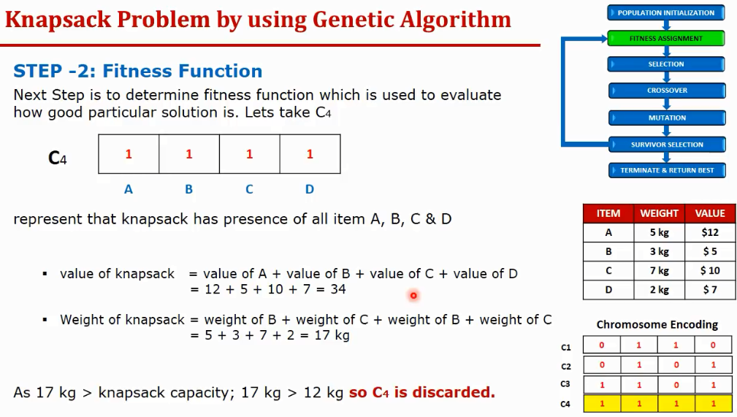

Slide 44
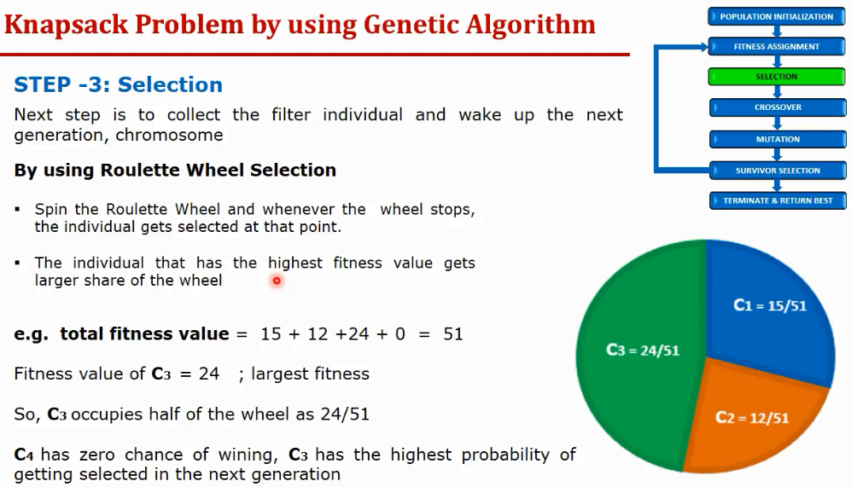

Slide 45
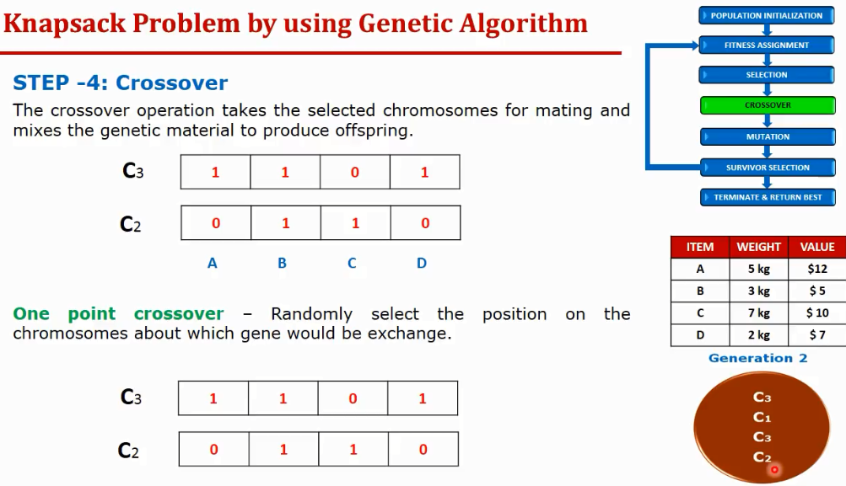

1

Slide 46
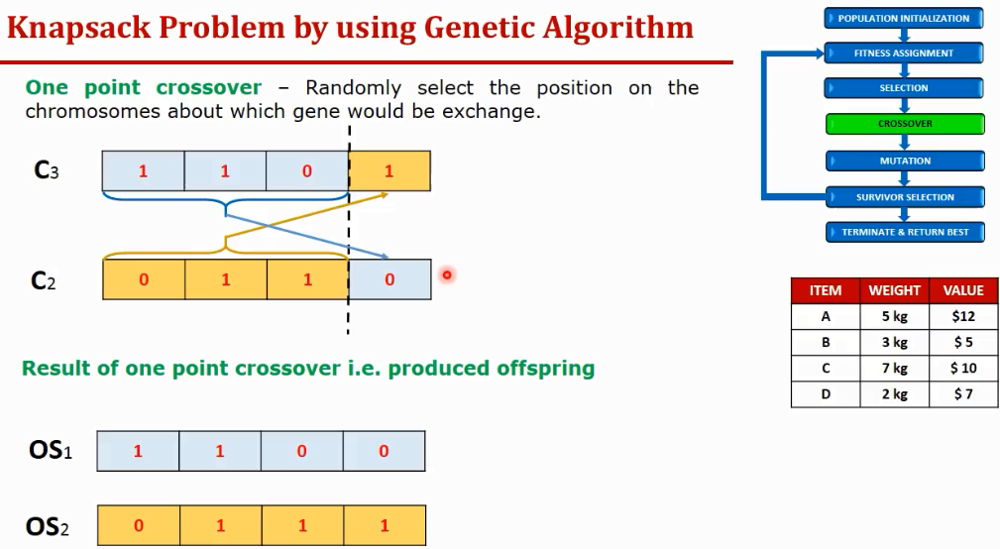

Slide 47
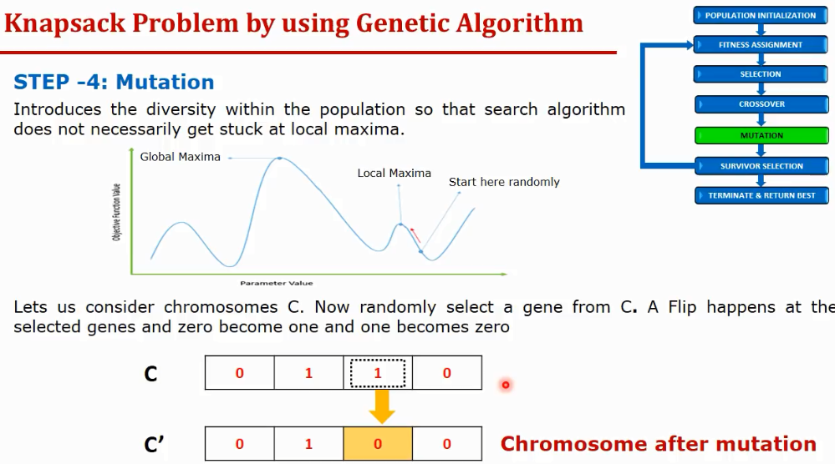

Slide 48
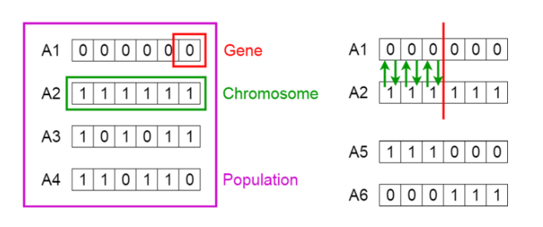
Practical issues to consider when using GA

Slide 49
Representation (encoding) affect solution quality
Binary Representation (bit strings)
Real Valued Representation
Integer Representation
Permutation Representation (each solution is an ordering of elements)

Slide 50
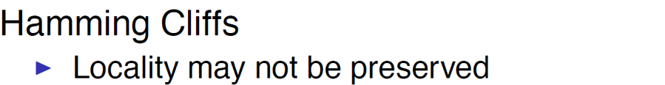
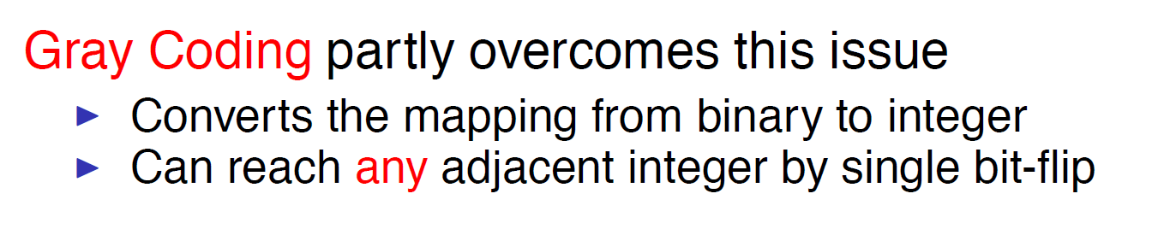
Revisiting Binary Representations
0111 = 7 but 0011 = 3 !
A small change in one bit may have a massive effect on the solution.

Slide 51
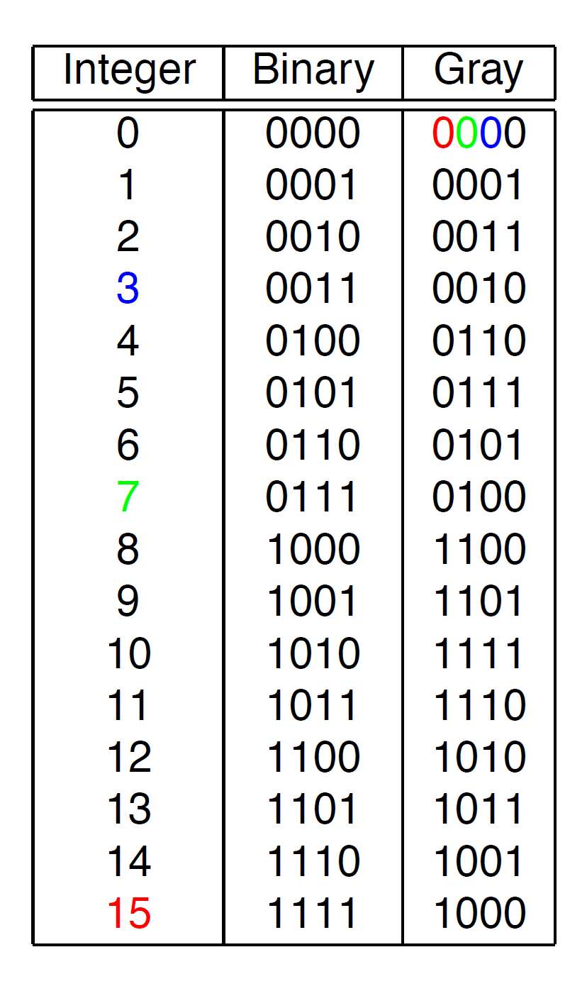
Gray coding (any two successive values differ in only one bit )

Slide 52
In-class practice
What is the grey coding for decimal numbers 10 and 15, respectively?

Slide 53
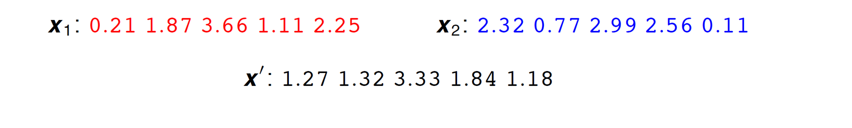
Real-valued representation
Real-valued representation has no hamming cliffs issue
Any binary arithmetic operator can be used as crossover
For example, “average”

Slide 54
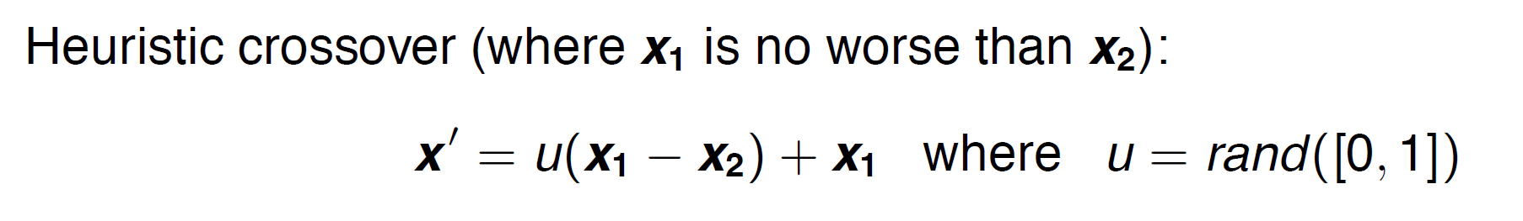
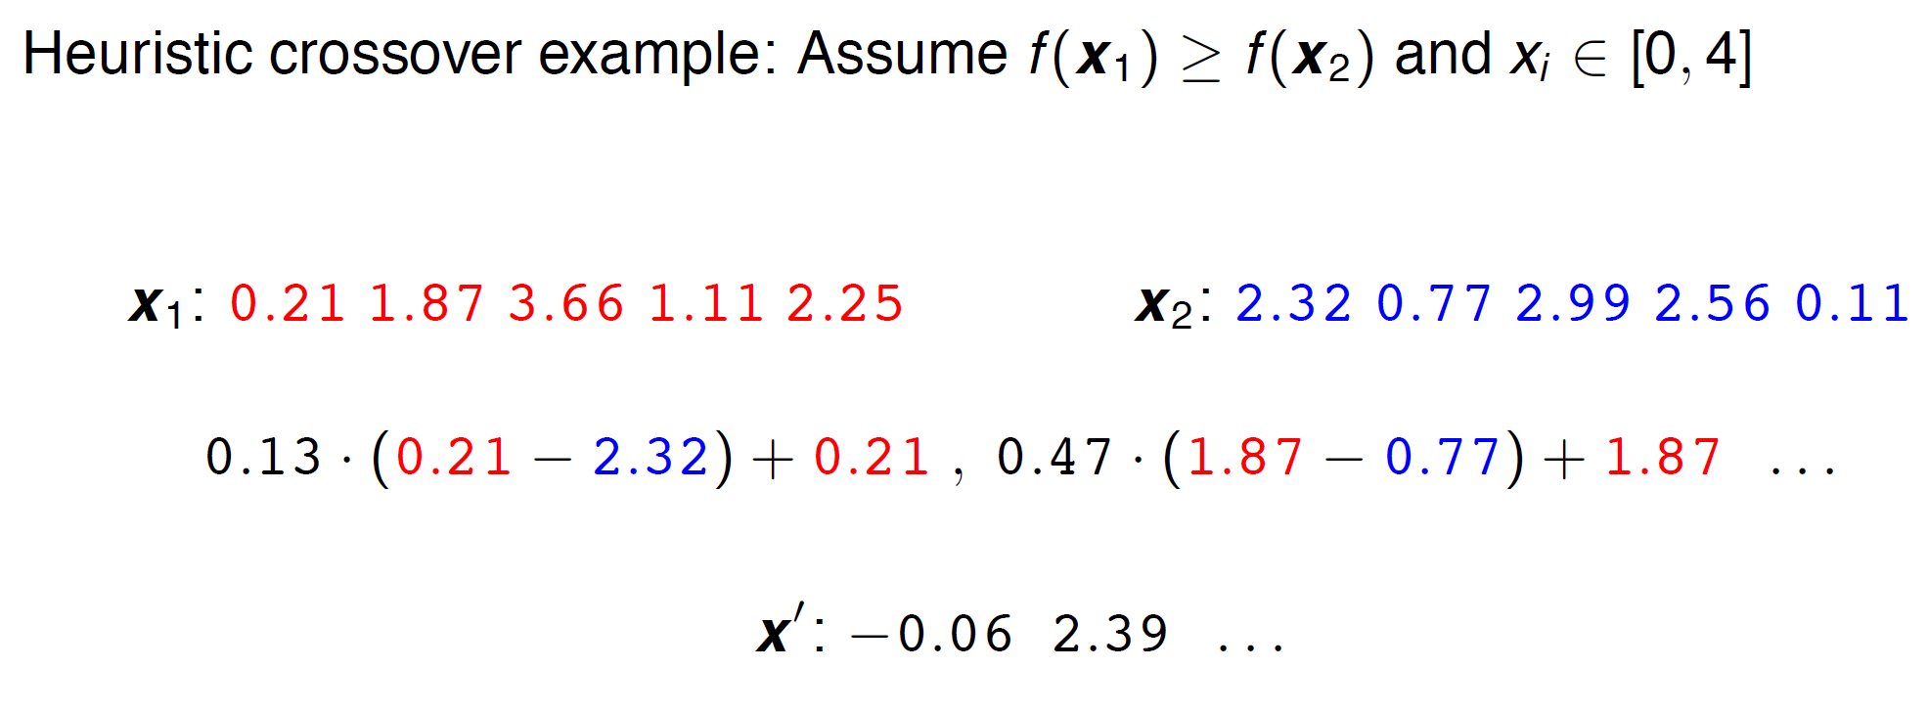
Real-valued representation

Slide 55
GA troubleshooting
Individual representation can largely affect the quality of the solution returned by GA. So if you decide to use GA, you should think about the best way to encode solutions for a given problem.
Try a few different crossover and mutate operators for a given problem.
If your selected crossover and mutate operators may generate “invalid offsprings”, you may assign those “invalid offsprings” a high penalty in the fitness function so that they can be excluded from the next generation automatically.

Slide 56

Famous 8-queen problem
The 8 queens puzzle is the problem of placing eight chess queens on an 8 × 8 chessboard so that no two queens attack each other

Slide 57
Famous 8-queen problem
How should we encode each chessboard as a chromosome, i.e., what would be the best way to create the numeric representation for each chessboard?
You will work on that in Project 4

Slide 58

GA versus NN

Slide 59
Advantages of GAs
Does not require any derivative information (failure of gradient based methods).
Optimizes both continuous and discrete functions and also multi-objective problems.
Provide near-optimal solutions in a short amount of time
Provides a list of “good” solutions and not just a single solution.
Useful when the search space is very large and there are a large number of parameters involved.

Slide 60
Limitations of GAs
GAs are not suited for all problems where derivative information is available.
Fitness value is calculated repeatedly which might be computationally expensive for some problems.
Being stochastic, there are no guarantees on the optimality or the quality of the solution.

Slide 61

GA implementation
https://github.com/DEAP/deap

Slide 62


DEAP installation

Slide 63

Bioinspired Robotics: Smarter, Softer, Safer
https://www.youtube.com/watch?v=RuLAn3XpYAU&t=184s

Slide 64

Biomimicry design
The world is poorly designed. But copying nature helps.
https://www.youtube.com/watch?v=iMtXqTmfta0

